Slide 1

DS 2003: Communicating with Data
Lecture: Research Fallacies

Slide 2

What does data tell us?
We live in a society obsessed with data
Data helps us make decisions
- Data-driven decision
- Data-informed decision

Slide 3
The difference between driven and informed
There is a fundamental difference between being data-driven and being data-informed.
Data-driven: You let the data guide your decision-making process
Data-informed: You let data act as a check on your intuition
When data guides your decision-making, it's recommended that you collect more data to have more accurate models and find trends.
Being data-informed means using both intuition and data to develop your hypotheses/ideas/thoughts.

Slide 4
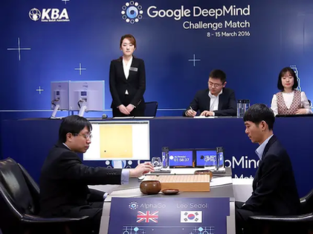
Example of Data Driven Decision-Making
AlphaGo vs. Lee Sedol
A five-game Go match between 18-time world champion Lee Sedol and AlphaGo, a computer Go program developed by Google DeepMind, played in Seoul, South Korea between 9 and 15 March 2016

Slide 5
AlphaGo vs. Lee Sedol
AlphaGo initially learned from thousands of games played by professional human players.
It decides on the next move based on a probability to win associated with each of the possible moves (using Monte Carlo simulations).
AlphaGo improves by playing against itself (using reinforcement learning).
As computing power grew exponentially, computers have become better than human at computation by many orders of magnitude.
At the end of the game, AlphaGo won by 4 against 1.
But in many situations, we want to leverage data to check on our intuition and make data-informed decisions.

Slide 6
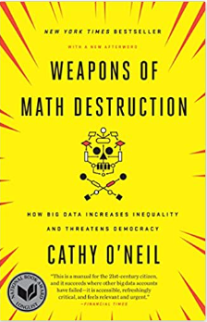
Why use a data-informed approach?
Of course, it's good because data is never going to tell you the full story.
But using it at face value to drive decision making can be rather dangerous.
This isn't a case of "garbage in = garbage out."

Slide 7
Data Fallacies

Slide 8
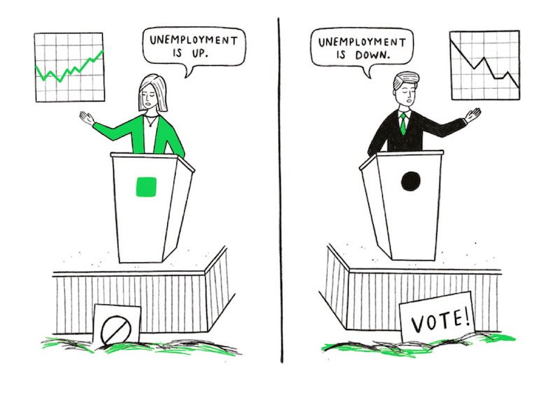
Cherry Picking
The practice of selecting results that fit your claim and excluding those that don’t
The worst and most harmful example of being dishonest with data

Slide 9
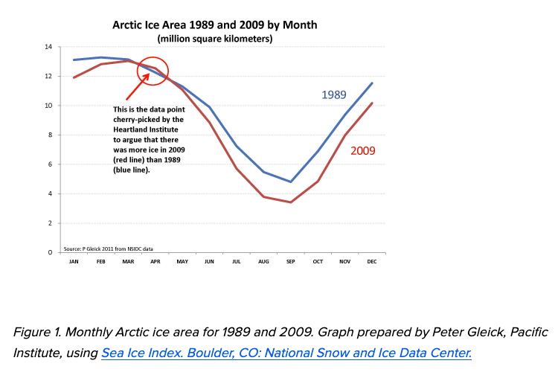
Cherry Picking
Example: Climate Science
In 2009, Harrison Schmitt, a former senator and astronaut sent a paper to NASA saying:
"How long this cooling trend will persist remains to be seen; however, Greenland glaciers have been advancing since 2009, Artic [sic] sea ice has returned to 1989 levels of coverage, and snowy, cold winters and cool summers have dominated northern North America and Europe.”
All four of these statements are wrong:
The Earth is not in a cooling trend, but a warming trend,
Greenland is losing ice, not gaining it (more evidence of warming),
Arctic sea ice in 2009 had not "returned to 1989 levels of coverage," and
Snowy, cold winters and cool summers do not dominate North America or Europe, nor would they refute the fact that the planet as a whole is warming.
So where did Schmitt get his information?
Gleick, Peter (2011). Misrepresenting Climate Science: Cherry-Picking Data to Hide the Disappearance of Arctic Ice. Huffpost Blog. Accessed July 20, 2022.

Slide 10
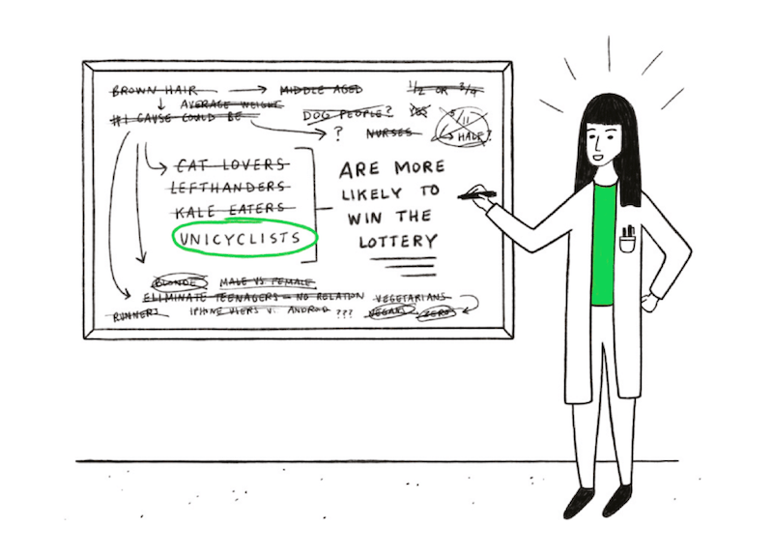
Data Dredging
The failure to acknowledge that the correlation was in fact the result of chance
Tests for statistical significance only work if you’ve defined your hypothesis upfront
Historically, this has been a problem with clinical trials where researchers have ‘data-dredged’ their results and switched what they were testing for. It explains why so many results published in scientific journals have subsequently been proven to be wrong

Slide 11
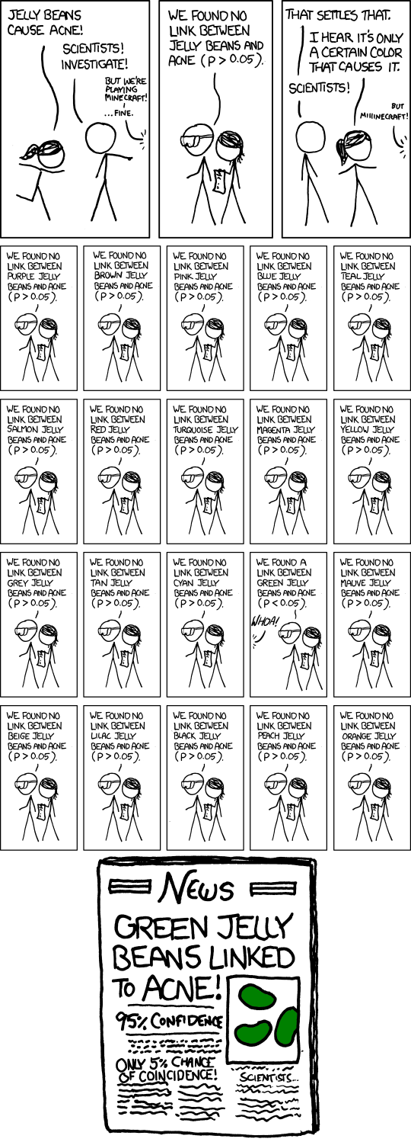
Data Dredging
Example: p-hacking
In traditional statistics, researchers rely heavily on the p value which is the probability that that there really is an effect (or no effect). If the p-value is sufficiently small, the result is declared significant.
There is a lot of pressure to produce statistically significant results, therefore p-hacking (intentional or not) has become pervasive.
In medicine, many clinical trial now require pre-registration which allows other scientists to confirm the researcher followed their initial design.
Additionally, the Open Science movement calls for publishing data and code to allows\ others to check work and reproduce results.

Slide 12
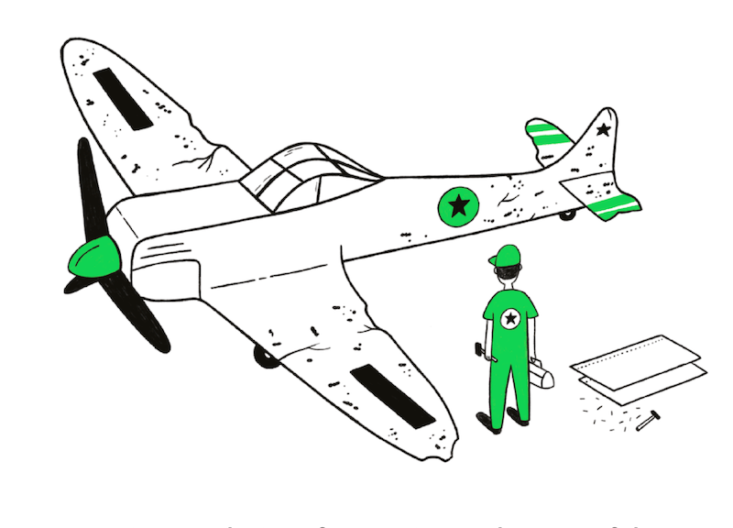
Survivorship Bias
When analyzing data, it’s important to ask yourself what data you don’t have.
Sometimes, the full picture is obscured because the data you’ve got has survived a selection of some sort.

Slide 13
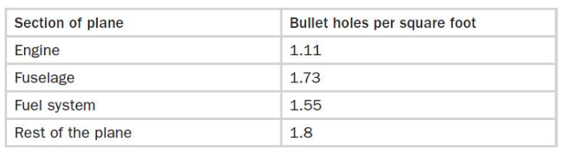
Survivorship Bias
Example: WWII Planes
Why was the fallacy represented by a plane?
In WWII, a team was asked where the best place was to fit armor to a plane.
The planes that came back from battle had bullet holes everywhere except the engine and cockpit.
Initially the team wanted to add more protection to the fuselage because that was the area with the most bullet holes.
However, thanks to the mathematician, Wald, The team decided it was best to fit armor where there were no bullet holes (engine), because planes shot in those places had not returned.

Slide 14

Cobra Effect
When an incentive produces the opposite result intended
Also known as the Perverse Incentive
Why is it called the Cobra Effect?

Slide 15
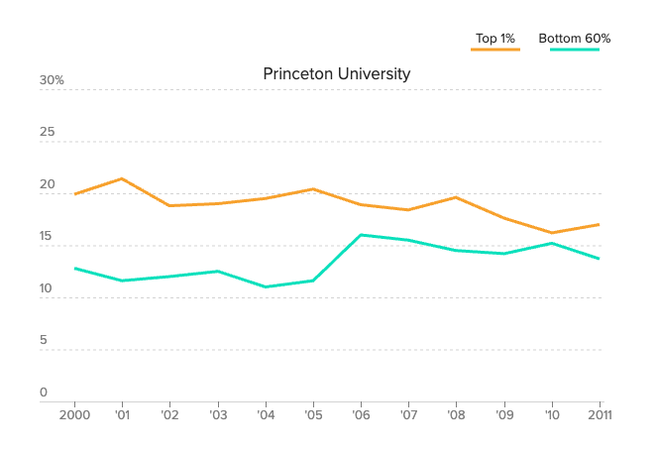
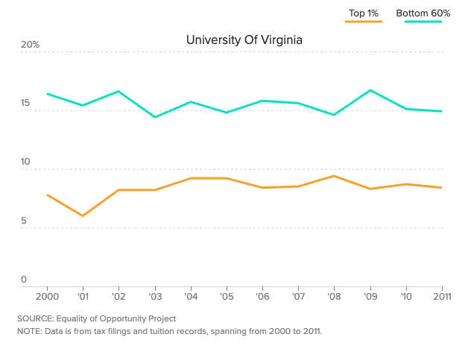
Cobra Effect
Example: U.S. News Best Colleges
In the 1980’s US News started to publish college rankings. These rankings have a lot pull in public opinion and many Higher Ed institutions try to ‘game’ the algorithm to move in the rankings.
However, this can shift the priority of schools from education, DEI, creating servant-leaders to financial decisions which hurt under-represented communities.
Note: US News rankings were developed to gain readership NOT push for better practices in higher ed. However, higher ed should be immune to algorithms created by journalists.
Admission Rate
Admission Rate
Graphs from: https://www.politico.com/interactives/2017/top-college-rankings-list-2017-us-news-investigation/

Slide 16
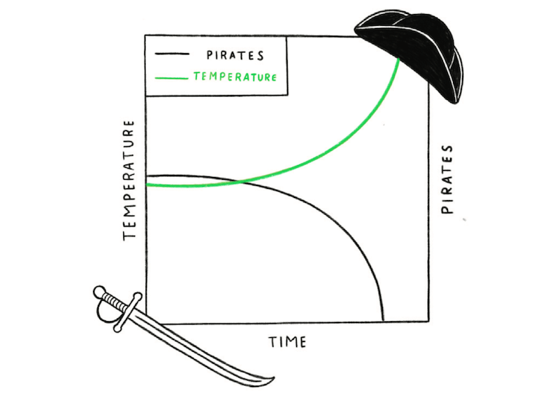
False Causality
To falsely assume when two events occur together that one must have caused the other
e.g., correlation is not causation
This is a commonly known fallacy
Example:
Global temperatures have steadily risen over the past 150 years and the number of pirates has declined at a comparable rate. No one would reasonably claim that the reduction in pirates caused global warming or that more pirates would reverse it. But it’s not usually this clear-cut.
Often correlations between two things tempt us to believe that one caused the other.
However, it’s often a coincidence or there’s a third factor causing both effects that you’re seeing. In our pirates and global warming example, the cause of both is industrialization.

Slide 17
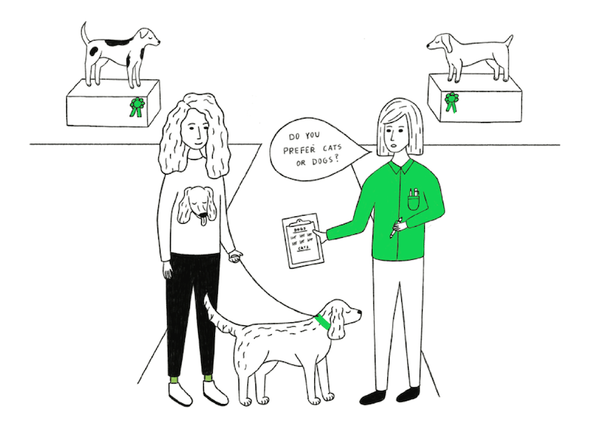
Sampling Bias
Drawing conclusions from a set of data that isn’t representative of the population you’re trying to understand.
Famous Example:
One famous example occurred in 1948 when The Chicago Tribune mistakenly predicted, based on a phone survey, that Thomas E. Dewey would become the next US president.
They hadn’t considered that only a certain demographic could afford telephones, excluding entire segments of the population from their survey.
Make sure to consider whether your research participants are truly representative and not subject to some sampling bias.

Slide 18
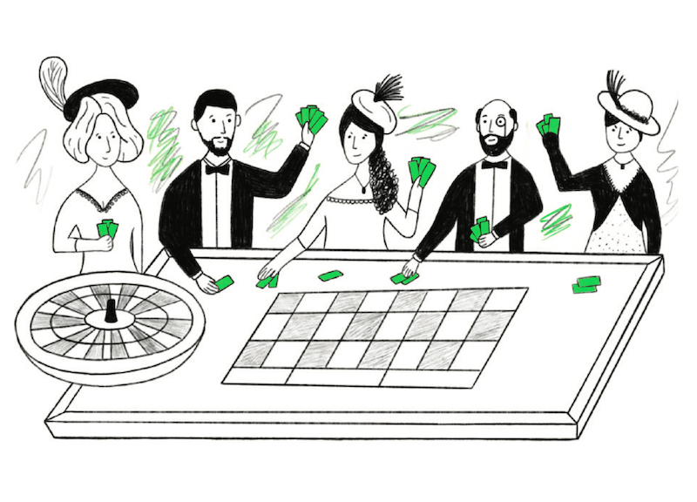
Gambler’s Fallacy
The mistaken belief that because something has happened more frequently than usual, it’s now less likely to happen in future and vice versa.
AKA the Monte Carlo Fallacy because of an infamous example that occurred at a roulette table there in 1913. The ball fell in black 26 times in a row and gamblers lost millions betting against black, assuming the streak had to end. However, the chance of black is always the same as red regardless of what’s happened in the past, because the underlying probability is unchanged. A roulette table has no memory.

Slide 19
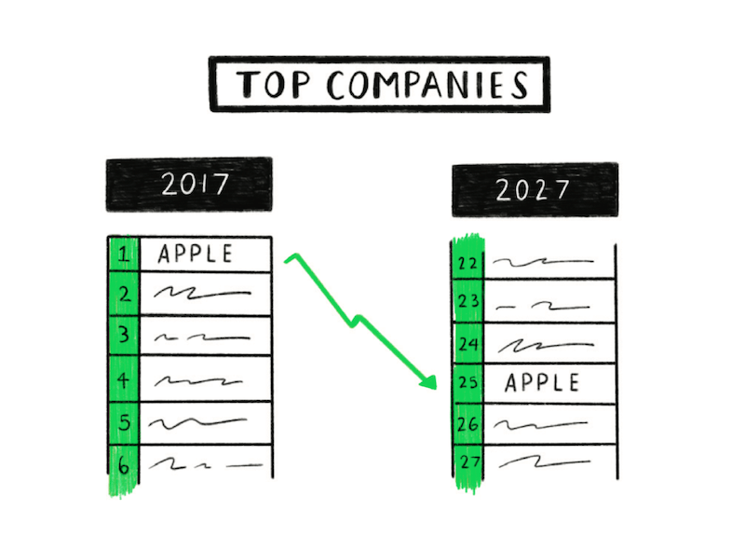
Regression to the Mean
When something happens that’s unusually good or bad, over time it will revert back towards the average
The sprinter that breaks the world record will probably run closer to their average time on the next race
Specifically, it refers to the tendency of a random variable that is highly distinct from the norm to return to "normal" over repeated tests

Slide 20
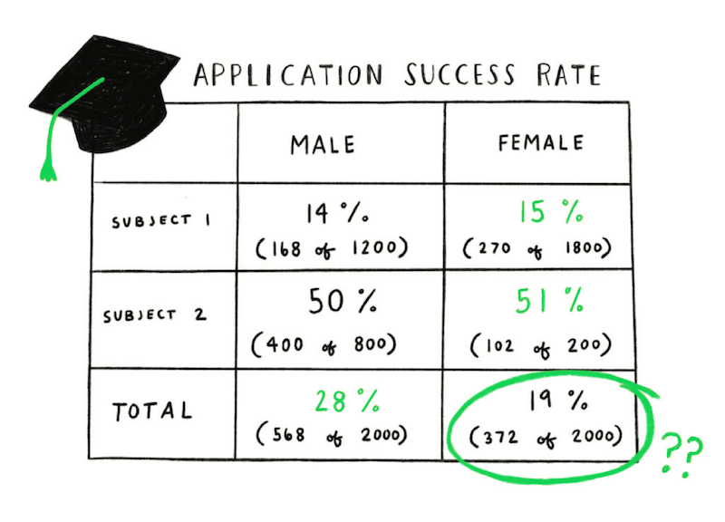
Simpson’s Paradox
A phenomenon in which a trend appears in different groups of data but disappears or reverses when the groups are combined.
Grouped data tells the opposite story of the ungrouped data.
This happens because of a confounding factor that is hidden from sight within the data.
 | Male | Female
Year 1 | ~50% | ~90% -> Many Females
Year 2 | ~50% | ~10% -> Few Females
Total | 100% | 100%
Year 1
Year 2

Slide 21
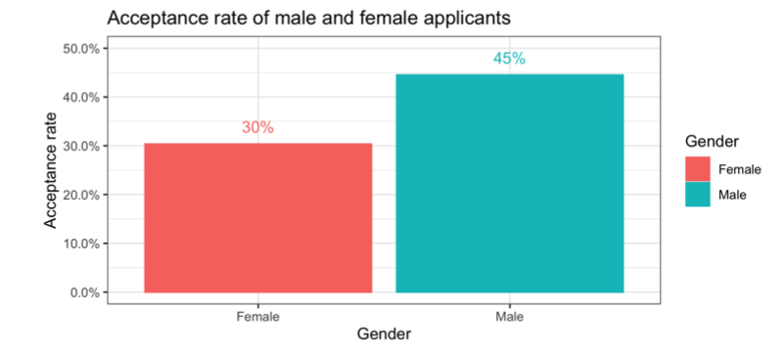
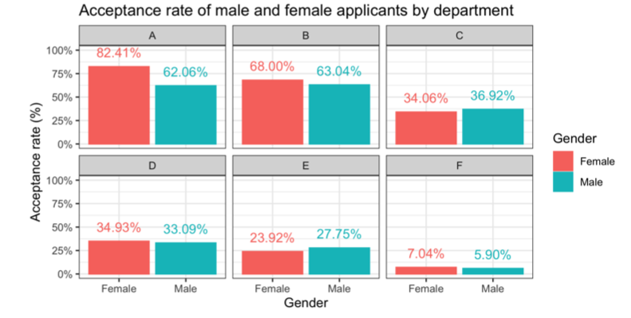
Simpson’s Paradox
Example: UC Berkeley
In 1973, UC Berkeley was sued for sex-discrimination.
It turned out of all the female students who applied — only 30% of them were admitted. While out all the male students who applied 45% of them were admitted.
In finding the main culprits of this discrimination, UC Berkeley found 4 of the 6 departments admitted more women than men
More females applied to departments with lower acceptance rates.

Slide 22
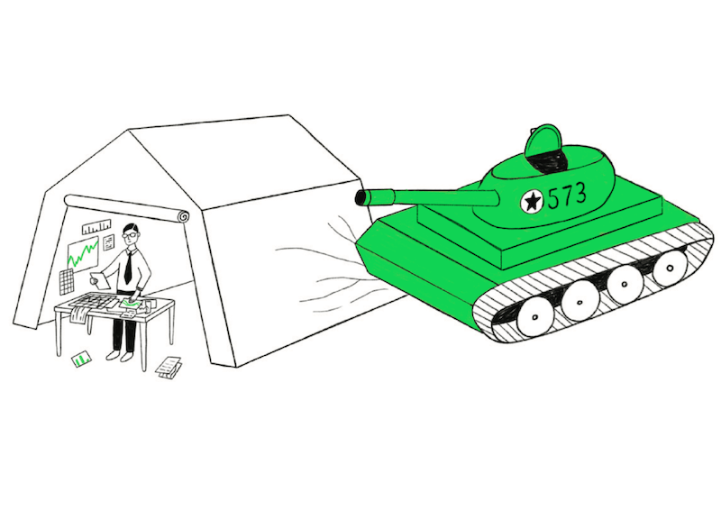
McNamara Fallacy
Relying solely on metrics in complex situations can cause you to lose sight of the bigger picture.
The fallacy refers to his approach of taking enemy body count as the measure of success in the Vietnam War. Obsessing over it meant that other relevant insights like the shifting mood of the U.S. public and the feelings of the Vietnamese people were largely ignored.
In data science, we need to be careful about proxies used, whether the outcome or the input

Slide 23
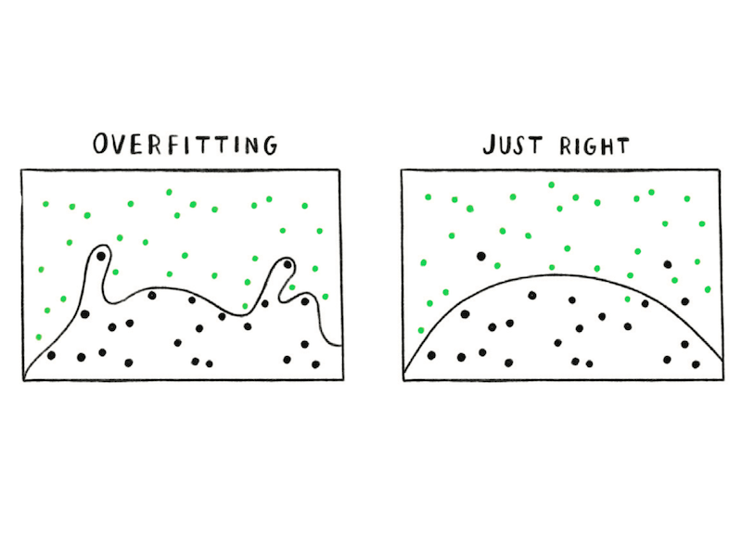
Overfitting
A more complex explanation will often describe your data better than a simple one. However, a simpler explanation is usually more representative of the underlying relationship.
An overfit model may represent your current data, but will usually fail to predict well in the future

Slide 24
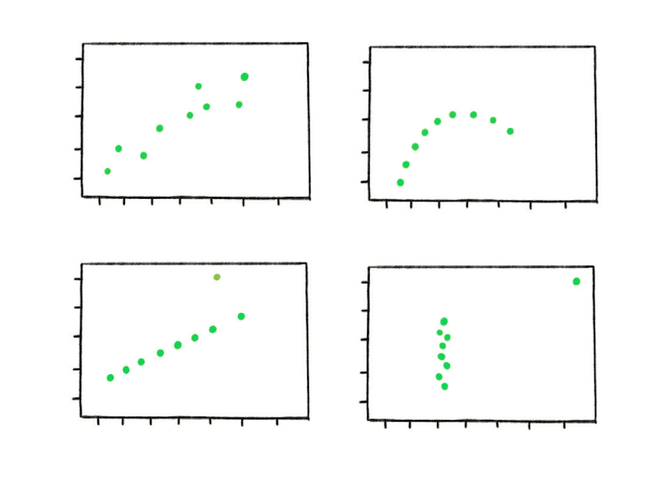
Danger of Summary Metrics
It can be misleading to only look at the summary metrics of data sets.
One way data viz can be helpful!

Slide 25
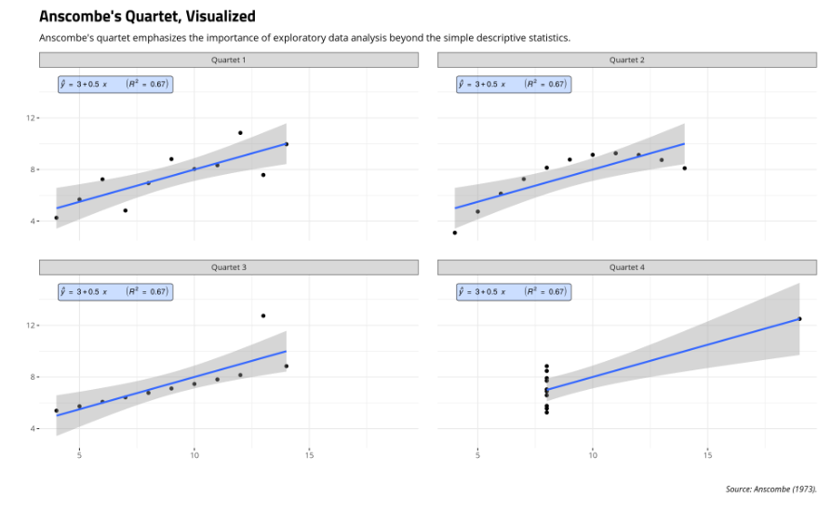
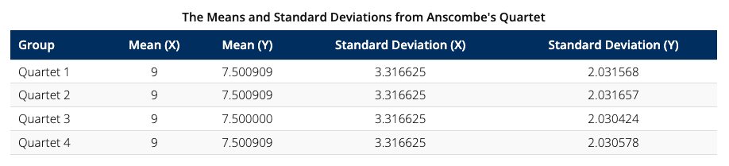
Danger of Summary Metrics
Example: Anscombe’s Quartet
Anscombe created four data sets, each with 11 observations and two variables (x and y).
All four quartets have the same mean for x and y, the same variance for x and y, the same regression line (y-intercept and slope for x), the same residual sum of squares, and the same correlation.
However, they look quite differently.

Slide 26
Additional Reading
P-hacking: https://www.nature.com/articles/506150a
Survivorship Bias: https://medium.com/@penguinpress/an-excerpt-from-how-not-to-be-wrong-by-jordan-ellenberg-664e708cfc3d
US News Rankings: Weapons of Math Destruction, Chapter 3
Monte Carlo Fallacy: https://rationalwiki.org/wiki/Gambler's_fallacy?_ga=2.239820419.1016940709.1658256080-826225427.1658256080&_gac=1.120662778.1658256080.CjwKCAjwrNmWBhA4EiwAHbjEQFDItmPm_uiKdTH1lKa-GpdoKw53rGBOYInH7oMHzs7xs0CWwqqAMBoCjJEQAvD_BwE

